Slide 1
Neural architecture search(NAS)
神经网络架构搜索

Slide 2
Motivation for architecture search
Designing neural network architectures is hard
Lots of human efforts go into tuning them
There is not a lot of intuition into how to design them well
Can we try and learn good architectures automatically?

Slide 3
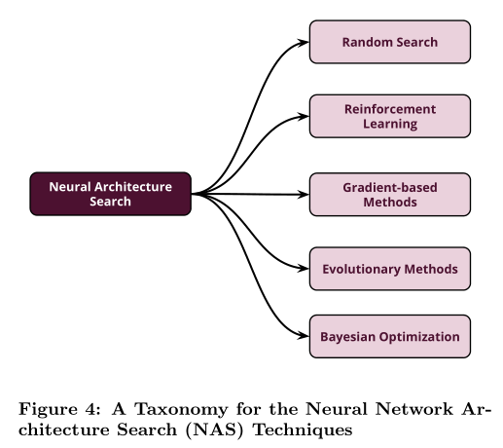
NAS
Broadly, NAS techniques falls into five main categories
including random search, reinforcement learning, gradient based methods, evolutionary methods, and Bayesian opti mization

Slide 4
Random Search
《Random Search and Reproducibility for Neural Architecture Search》(2019)
Two Observations：
(i) random search is a competitive baseline for hyperparameter optimization.
(ii) NAS is a specialized hyperparameter optimization problem
Leveraging the observations:
evaluate both random search with early-stopping and a novel random search with weight-sharing algorithm on two standard NAS benchmarks—PTB and CIFAR-10
Three fundamental issues with the current state of NAS research：
Inadequate Baselines
Complex Methods
Lack of Reproducibility

Slide 5
Random Search
《Random Search and Reproducibility for Neural Architecture Search》(2019)
Two Observations：
(i) random search is a competitive baseline for hyperparameter optimization.
(ii) NAS is a specialized hyperparameter optimization problem
Leveraging the observations:
evaluate both random search with early-stopping and a novel random search with weight-sharing algorithm on two standard NAS benchmarks—PTB and CIFAR-10
Three fundamental issues with the current state of NAS research：
Inadequate Baselines
Complex Methods
Lack of Reproducibility

Slide 6
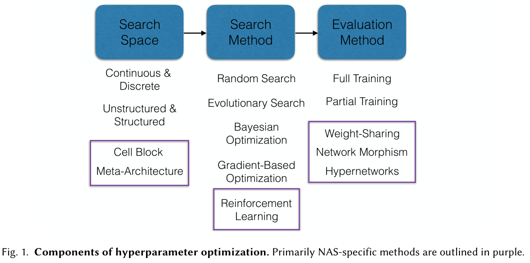
Random Search
An overview of the components of hyperparameter optimization and, by association, NAS
A general hyperparameter optimization problem has three components, each of which can have NAS-specific approaches

Slide 7
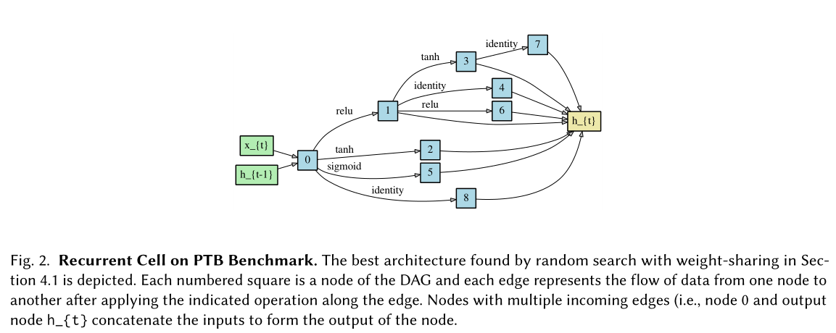
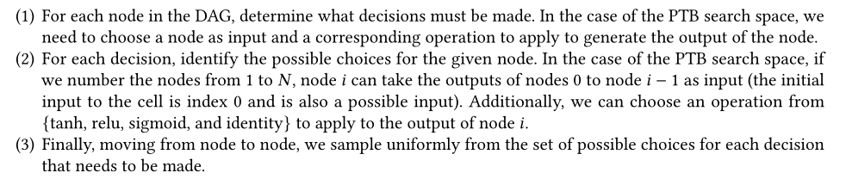
Random Search
NAS algorithm that combines random search with weight-sharing

Slide 8
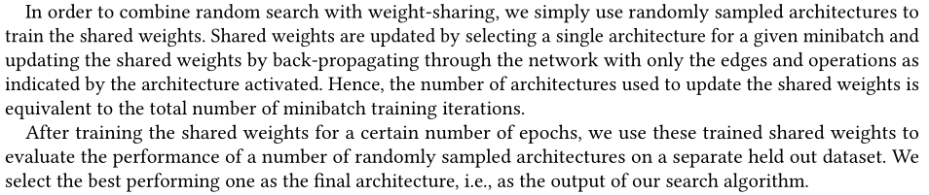
Random Search
NAS algorithm that combines random search with weight-sharing
(1) selecting a single architecture for a given minibatch
(2) updating the shared weights by back-propagating through the network with only the edges and operations as indicated by the architecture activated
(3) the number of architectures used to update the shared weights is equivalent to the total number of minibatch training iterations

Slide 9
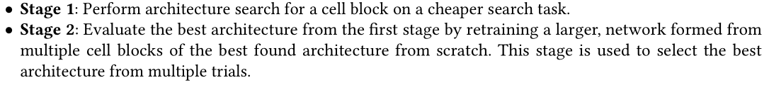
Random Search
EXPERIMENTS
To evaluate the performance of random search with weight-sharing on two benchmarks：

Slide 10
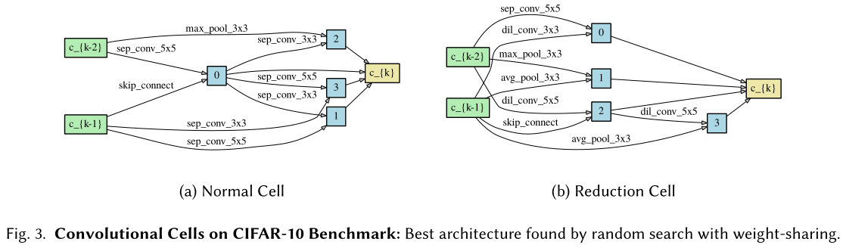
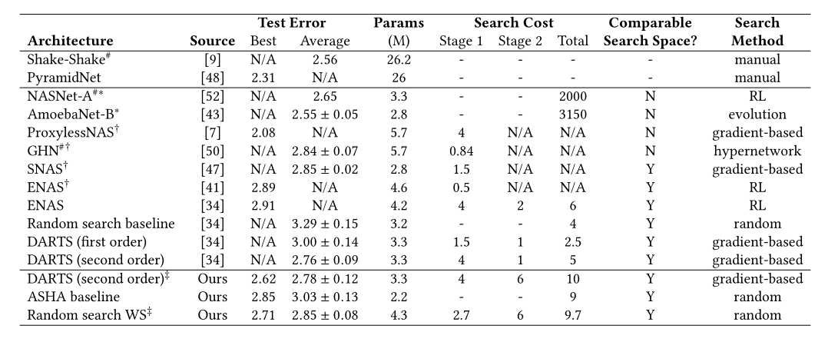
Random Search
EXPERIMENTS
CIFAR-10 Benchmark

Slide 11
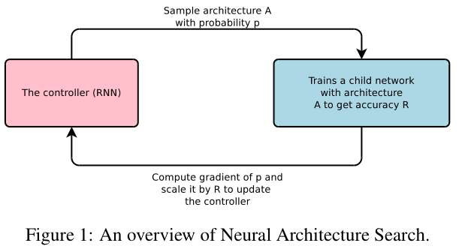
Reinforcement Learning
《Neural architecture search with reinforcement learning》
In this paper, we use a recurrent network to generate the model descriptions of neural networks and train this RNN with reinforcement learning to maximize the expected accuracy of the generated architectures on a validation set.
Neural network can be typically specified by a variable-length string
Use a recurrent network – the controller – to generate such string
Training the network specified by the string – the “child network”
on the real data will result in an accuracy on a validation set
Using this accuracy as the reward signal, compute the policy gradient
to update the controller
In the next iteration, the controller will give higher probabilities to
architectures that receive high accuracies
policy gradient： To maximize the expected accuracy of the sampled architectures

Slide 12
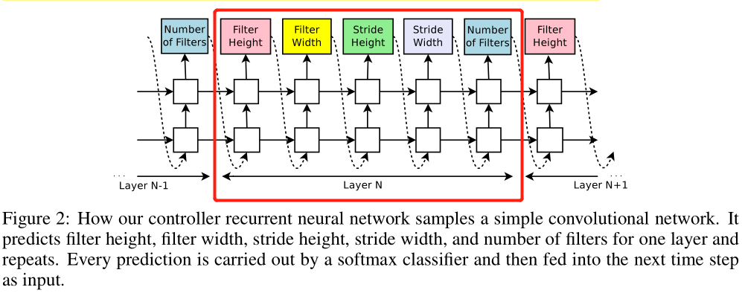
Reinforcement Learning
Generate model descriptions with a controller recurrent neural network
To be flexible, the controller is implemented as a recurrent neural network (RNN)
Suppose we would like to predict feedforward neural networks with only convolutional layers
the process of generating an architecture stops if the number of layers exceeds a certain value
Notes:
选RNN作为contoller的原因是：RNN比较灵活
假设我们想要预测只有卷积层的前馈神经网络：对于每一层，RNN预测filter height, filter width, stride height, stride width, number of filters 。每个预测由一个softmax分类器执行，然后输入到下一个时间步作为输入。
如果层的数量超过某个值，则生成过程停止

Slide 13
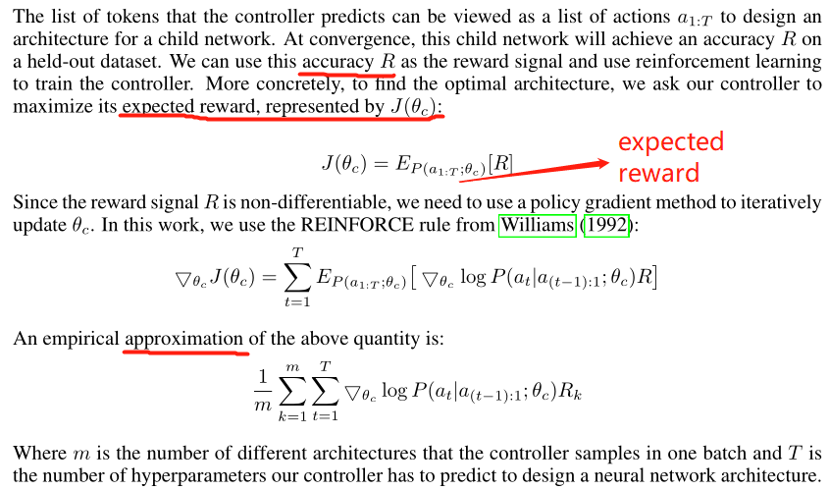
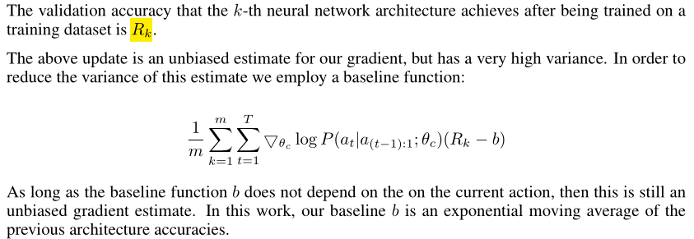
Reinforcement Learning
Training with reinforce

Slide 14
Reinforcement Learning
Experiments—learning convolutional architectures for cifar-10
Training details:
The controller RNN is a two-layer LSTM with 35 hidden units on each layer. It is trained with the ADAM optimizer with a learning rate of 0.0006.
The weights of the controller are initialized uniformly between -0.08 and 0.08.
Once the controller RNN samples an architecture, a child model is constructed and trained for 50 epochs
The reward used for updating the controller is the maximum validation accuracy of the last 5 epochs cubed
The validation set has 5,000 examples randomly sampled from the training set, the remaining 45,000 examples are used for training.
On CIFAR-10, we ask the controller to increase the depth by 2 for the child models every 1,600 samples, starting at 6 layers.

Slide 15
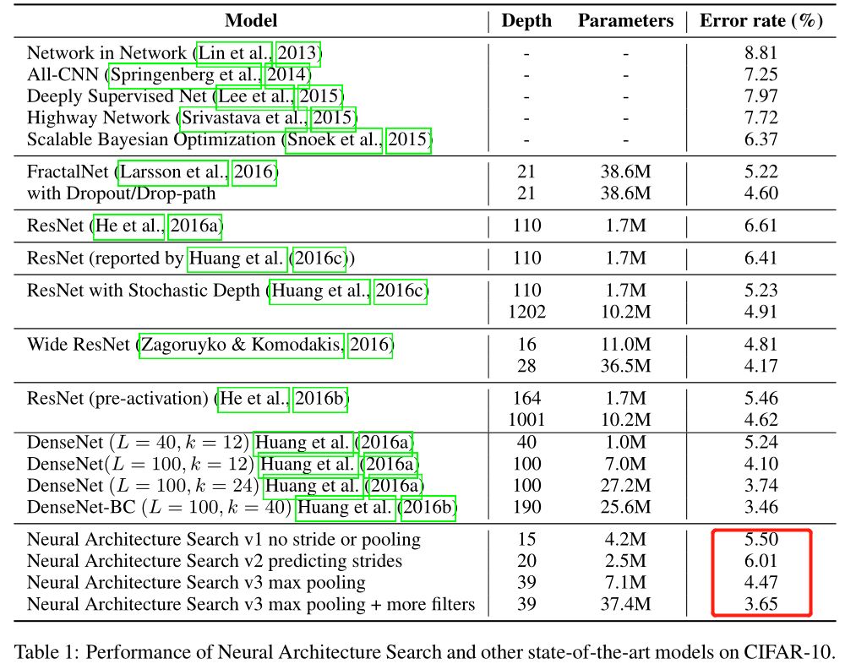
Reinforcement Learning
Experiments—learning convolutional architectures for cifar-10
Results
After the controller trains 12,800 architectures, we find the architecture that achieves the best validation accuracy.
Neural Architecture Search can design several promising architectures that perform as well as some of the best models on this dataset.

Slide 16
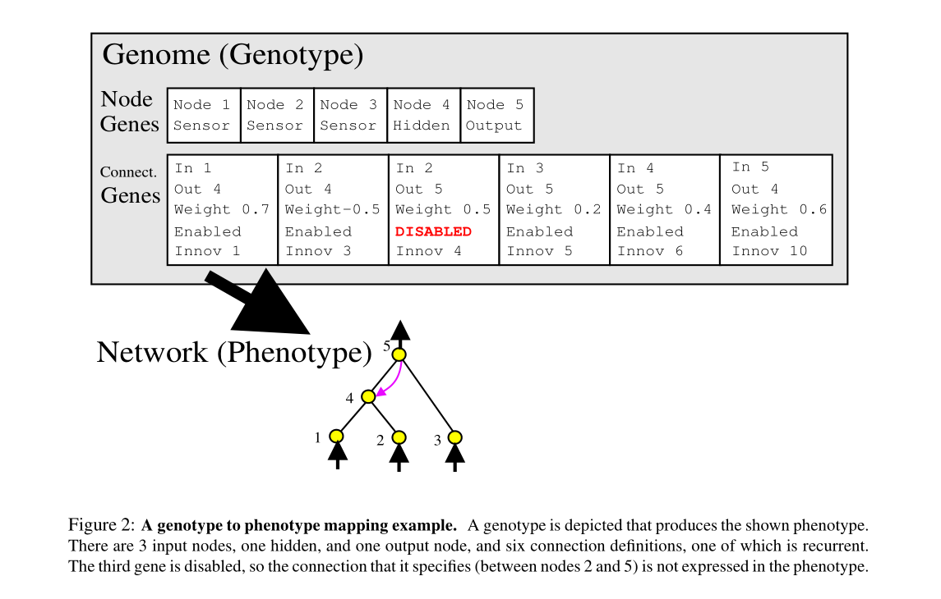
Evolutionary Method
《Evolving Neural Networks through Augmenting Topologies》
NEAT： NeuroEvolution of Augmenting Topologies

Slide 17
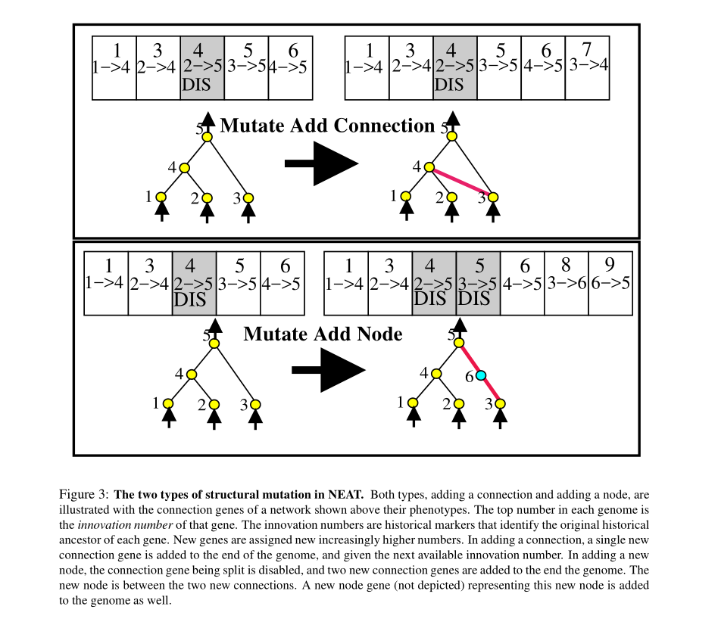
NeuroEvolution of Augmenting Topologies (NEAT)

Slide 18
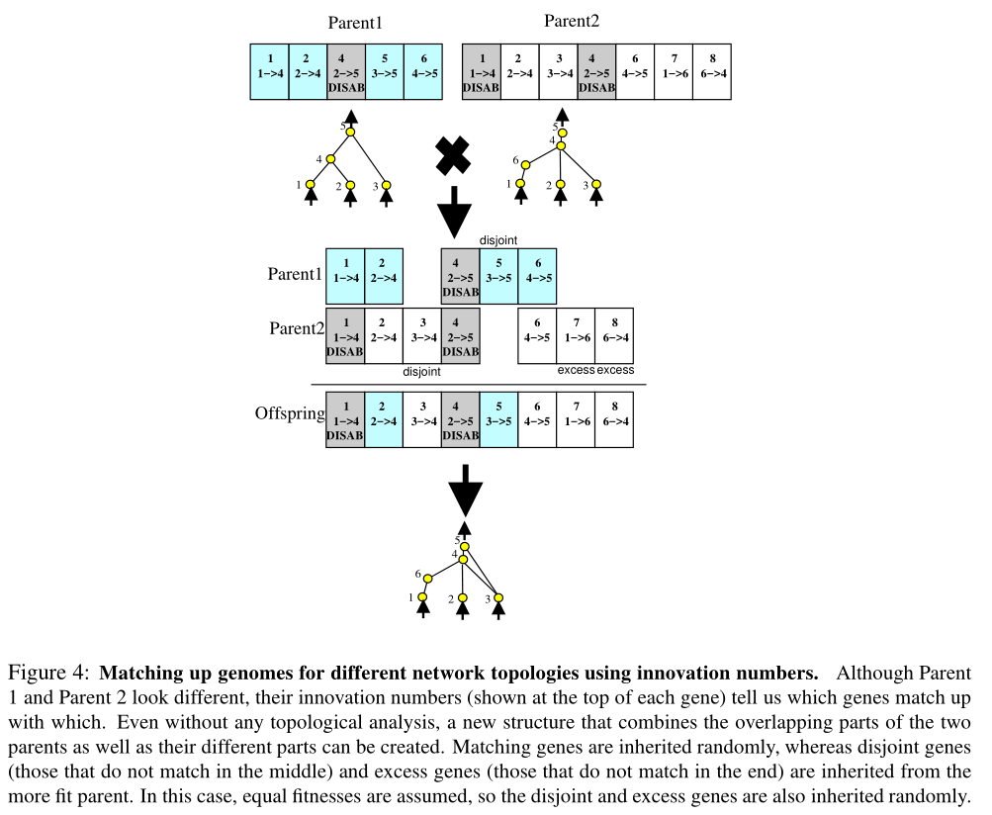
NeuroEvolution of Augmenting Topologies (NEAT)

Slide 19
CoDeepNEAT
《Evolutionary Neural AutoML for Deep Learning》
CoDeepNEAT follows the same fundamental process as NEAT:
First,apopulationofchromosomesofminimalcomplexityiscreated.
Each chromosome is represented as a graph and is also referred to as an individual.
Over generations, structure (i.e. nodes and edges) is added to the graph incrementally through mutation. As in NEAT, mutation involves randomly adding a node or a connection between two nodes.
During crossover, historical markings are used to determine how genes of two chromosomes can be lined up and how nodes can be randomly crossed over.
The population is divided into species (i.e. subpopulations) based on a similarity metric.
Each species grows proportionally to its fitness and evolution occurs separately in each species.

Slide 20
CoDeepNEAT
CoDeepNEAT differs from NEAT in that each node in the chromosome no longer represents a neuron, but instead a layer in a DNN. Each node contains a table of real and binary valued hyperparameters that are mutated through uniform Gaussian distribution and random bit-flipping, respectively. These hyperparameters determine the type of layer (such as convolutional, fully connected, or recurrent) and the properties of that layer (such as number of neurons, kernel size, and activation function). The edges in the chromosome are no longer marked with weights; instead they simply indicate how the nodes (layers) are connected. The chromosome also contains a set of global hyperparameters applicable to the entire network (such as learning rate, training algorithm, and data preprocessing).

Slide 21
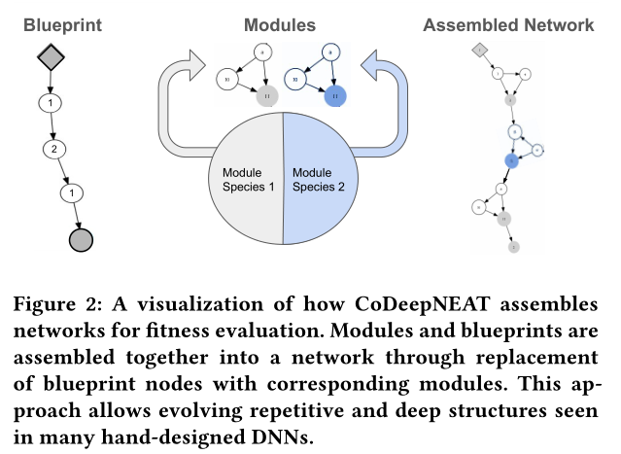
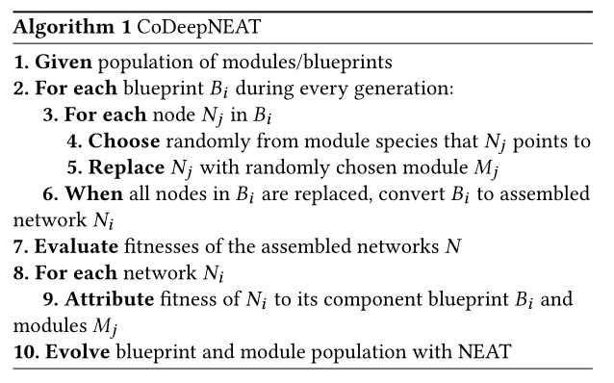
CoDeepNEAT
Cooperative Coevolution of Modules and Blueprints

Slide 22
CoDeepNEAT in the CIFAR-10 Benchmark
In this experiment, CoDeepNEAT was used to evolve the topology of a convolutional neural network (CNN) to maximize its classifcation performance on the CIFAR-10 dataset, a common image classifcation benchmark.
CoDeepNEAT was initialized with populations of 25 blueprints and 45 modules.
From these two populations, 100 CNNs were assembled for fitness evaluation in every generation.
Each node in the module chromosome represents a convolutional layer.
Its hyperparameters determine the various properties of the layer and whether additional max-pooling or dropout layers are attached
In addition, a set of global hyperparameters were evolved for the assembled network.
During fitness evaluation, the 50,000 images were split into a training set of 42,500 samples and a validation set of 7,500 samples.
After evolution was complete, the best network was trained on all 50,000 training images for 300 epochs, and the classification error measured.

Slide 23
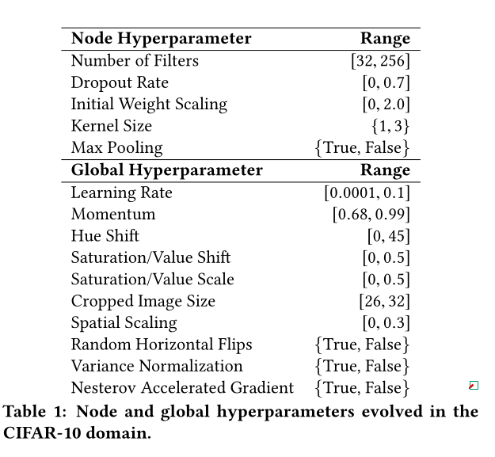
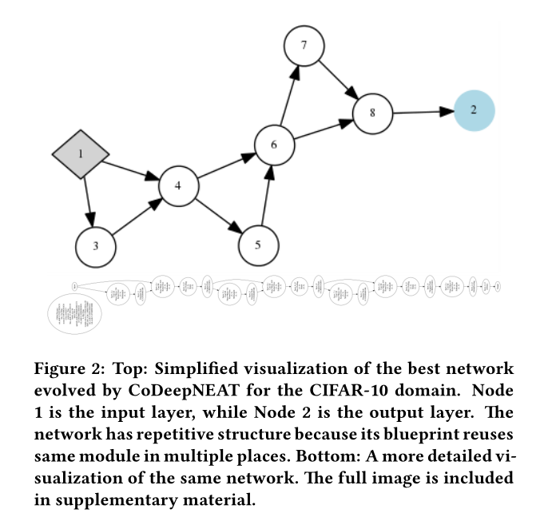
CoDeepNEAT in the CIFAR-10 Benchmark

Slide 24
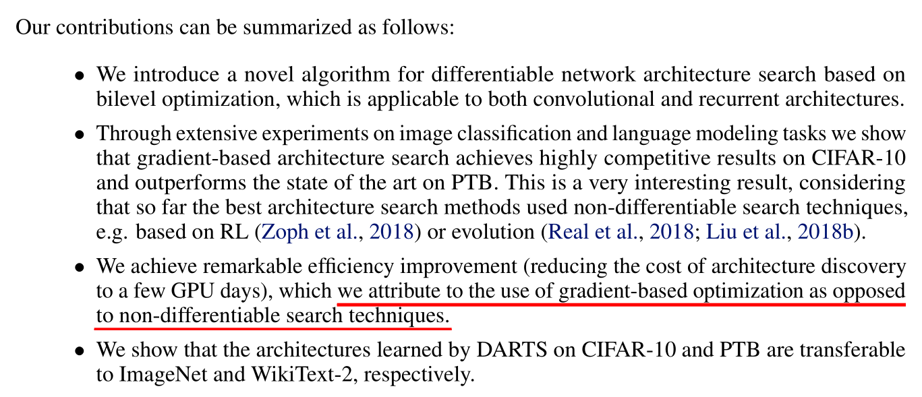
Gradient-based Method
《DARTS: DIFFERENTIABLE ARCHITECTURE SEARCH》

Slide 25
DARTS
Search Space
目标：搜索一种Convolutional Cell(有向无环图，其中包含​N​个节点)作为网络最终结构的Building Block，得到的Cell既可以通过Stack成Convolutiona network，也可以循环连接形成Recurrent Network.
A cell is a directed acyclic graph consisting of an ordered sequence of N nodes
Each node x (i) is a latent representation (e.g. a feature map in convolutional networks) and each directed edge (i,j) is associated with some operation o (i,j) that transforms x (i) .

Slide 26
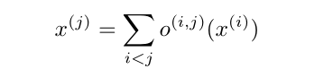
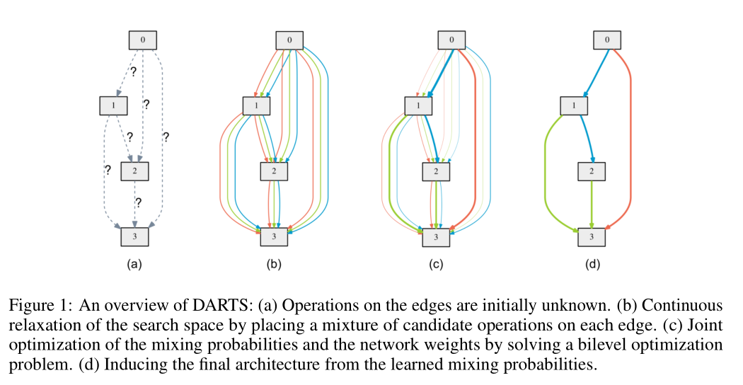
DARTS
CONTINUOUS R ELAXATION AND O PTIMIZATION
Each intermediate node is computed based on all of its predecessors:

Slide 27
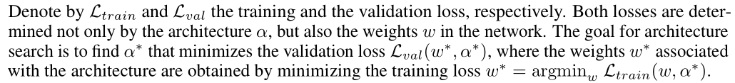
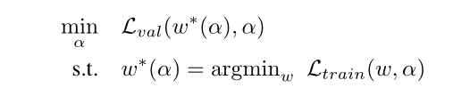
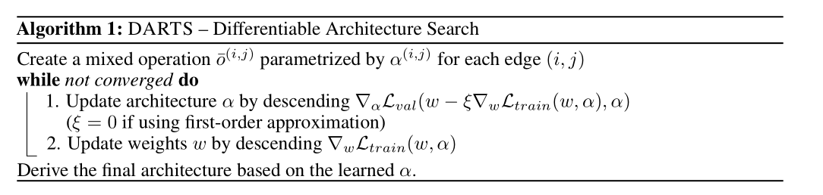
DARTS
S
This implies a bilevel optimization problem (Anandalingam & Friesz, 1992; Colson et al., 2007) with α as the upper-level variable and w as the lower-level variable:

Slide 28
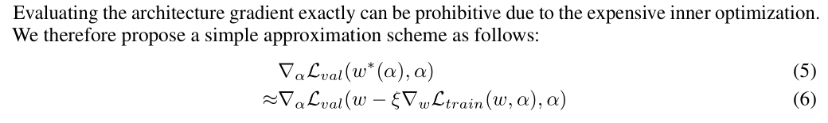
DARTS
近似结构梯度(APPROXIMATE ARCHITECTURE GRADIENT)

Slide 29
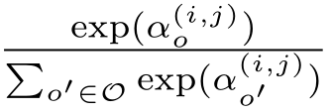
DARTS
推导离散结构（DERIVING D ISCRETE A RCHITECTURES）
To form each node in the discrete architecture, we retain the top- k strongest operations (from distinct nodes) among all non-zero candidate operations collected from all the previous nodes.
The strength of an operation is defined as ：

Slide 30
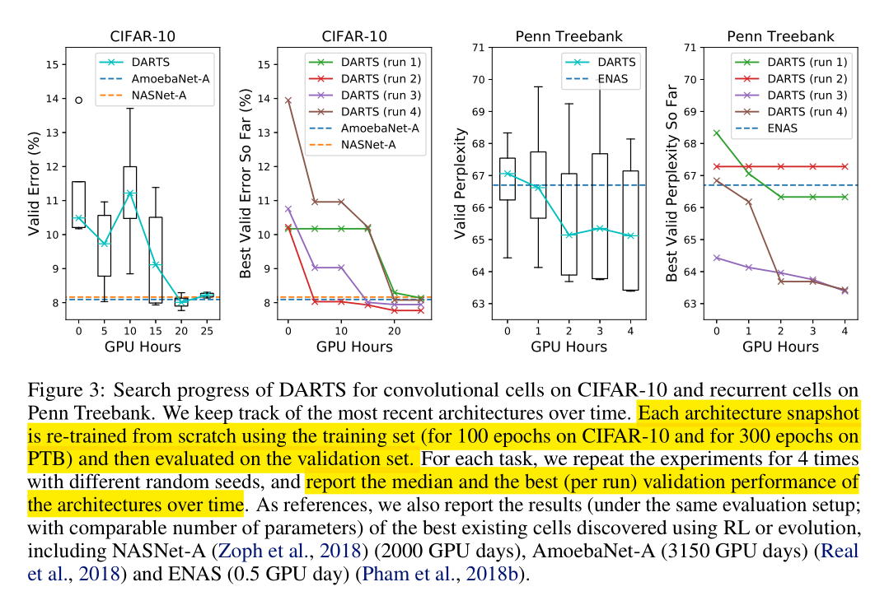
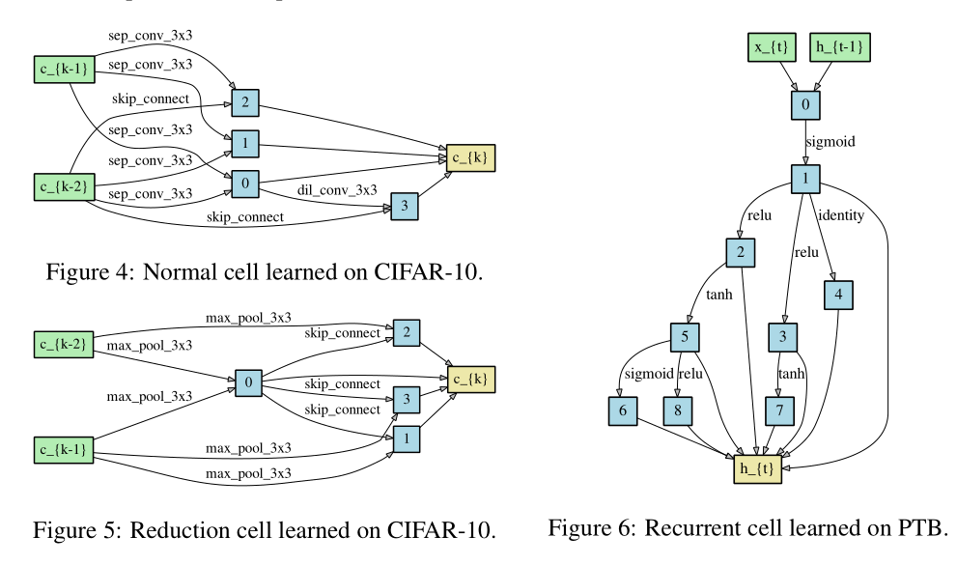
DARTS
实验结果（EXPERIMENTS AND R ESULTS）

Slide 31
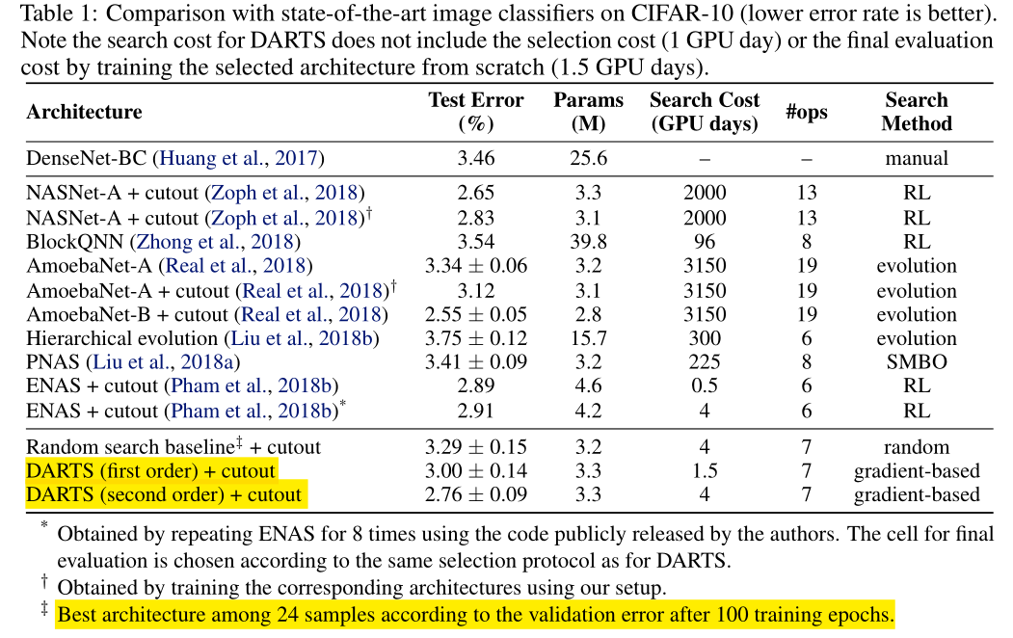
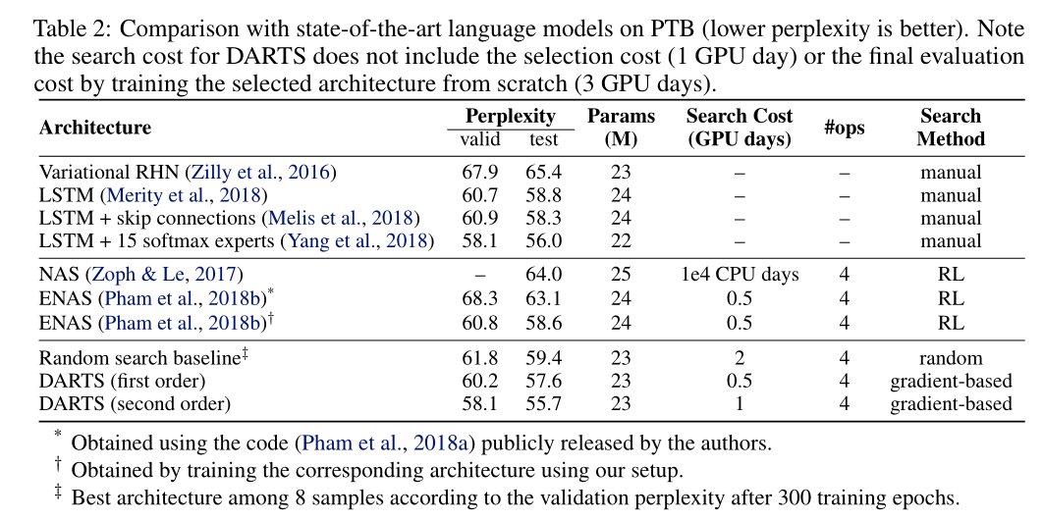
DARTS
实验结果（EXPERIMENTS AND R ESULTS）

Slide 32
NAO(nerual architecture optimization)
《Neural Architecture Optimization》
Three key components in proposed approach:
(1) An encoder embeds/maps neural network architectures into a continuous space.
(2) A predictor takes the continuous representation of a network as input and predicts its accuracy.
(3) A decoder maps a continuous representation of a network back to its architecture.
The performance predictor and the encoder enable us to perform gradient based optimization in the continuous space to find the embedding of a new architecture with potentially better accuracy.

Slide 33
NAO(nerual architecture optimization)
《Neural Architecture Optimization》
Three key components in proposed approach:
(1) An encoder embeds/maps neural network architectures into a continuous space.
(2) A predictor takes the continuous representation of a network as input and predicts its accuracy.
(3) A decoder maps a continuous representation of a network back to its architecture.
The performance predictor and the encoder enable us to perform gradient based optimization in the continuous space to find the embedding of a new architecture with potentially better accuracy.
优势：
(1) continuous representation of an architecture is more compact and efficient in representing its topological information
(2) optimizing in a continuous space is much easier than directly searching with in discrete space due to better smoothness

Slide 34
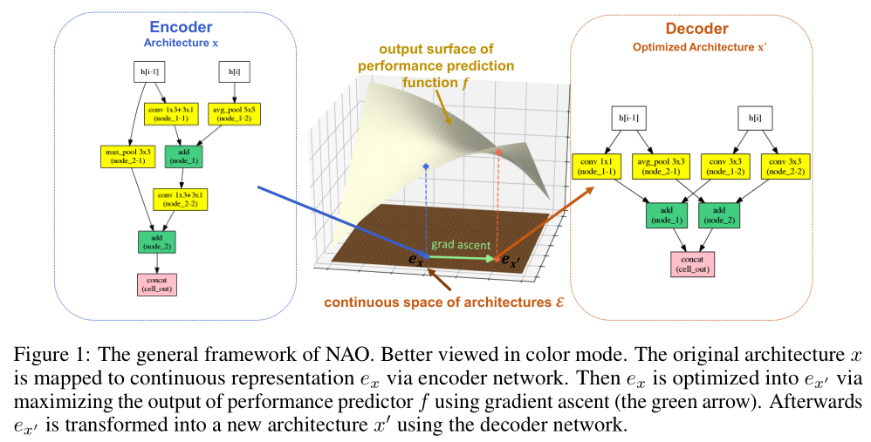
NAO(nerual architecture optimization)
Encoder: The core of NAO is an encoder model responsible to map a neural network architecture into a continuous representation (the blue arrow in the left part of Fig. 1)
Predictor: On top of the continuous representation we build a regression model to approximate the final performance (e.g., classification accuracy on the dev set) of an architecture (the yellow surface in the middle part of Fig. 1)
Decoder: another key module for NAO is designed to act as the decoder recovering the discrete architecture from the continuous representation (the red arrow in the right part of Fig. 1). The decoder is an LSTM model equipped with an attention mechanism that makes the exact recovery easy

Slide 35
NAO(nerual architecture optimization)
The most recent work parallel to ours is DARTS ,which relaxes the discrete architecture space to continuous one by mixture model and utilizes gradient based optimization to derive the best architecture.
One hand, both NAO and DARTS conducts continuous optimization via gradient based method.
on the other hand, the continuous space in the two works are different: in DARTS it is the mixture weights and in NAO it is the embedding of neural architectures.
The difference in optimization space leads to the difference in how to derive the best architecture from continuous space: DARTS simply assumes the best decision (among different choices of architectures) is the argmax of mixture weights while NAO uses a decoder to exactly recover the discrete architecture.

Slide 36
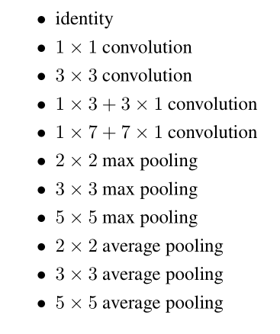
NAO(nerual architecture optimization)
Architecture Space
For searching CNN architecture:
A cell is a convolutional neural network containing B nodes
Each of the nodes contains two branches, with each branch taking the output of one of the former nodes as input and applying an operation to it
The node adds the outputs of its two branches as its output
The inputs of the cell are the outputs of two previous cells, respectively denoted as node −2 and node −1
Finally, the outputs of all the nodes that are not used by any other nodes are concatenated to form the final output of the cell

Slide 37
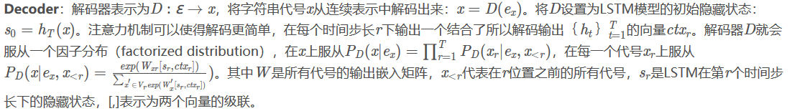
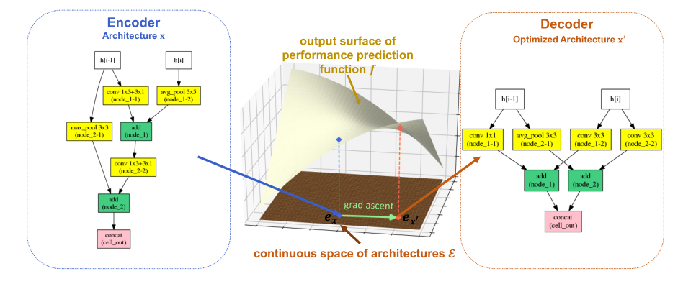
NAO(nerual architecture optimization)

Slide 38
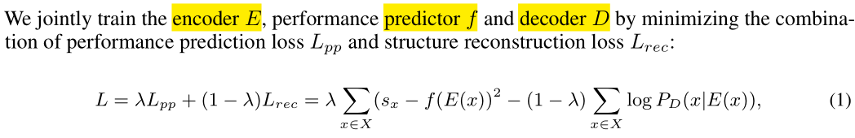
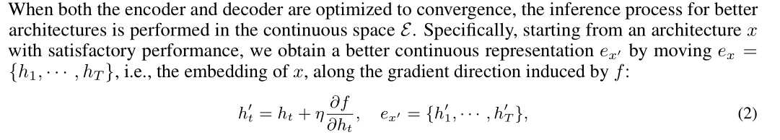
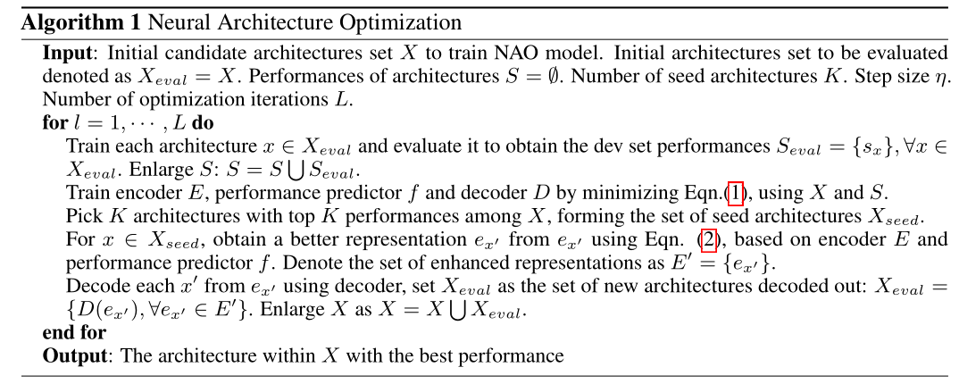
NAO(nerual architecture optimization)
Training and Inference

Slide 39
NAO(nerual architecture optimization)
Results on CIFAR-10 Classification

Slide 40
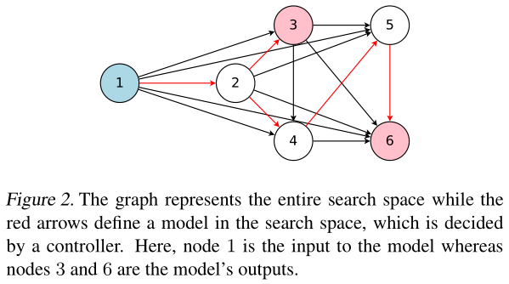
ENAS（ Efficient Neural Architecture Search ）
《Efficient Neural Architecture Search via Parameter Sharing》
In ENAS, a controller discovers neural network architectures by searching for an optimal subgraph within a large computational graph.
The controller is trained with policy gradient to select a subgraph that maximizes the expected reward on a validation set.

Slide 41
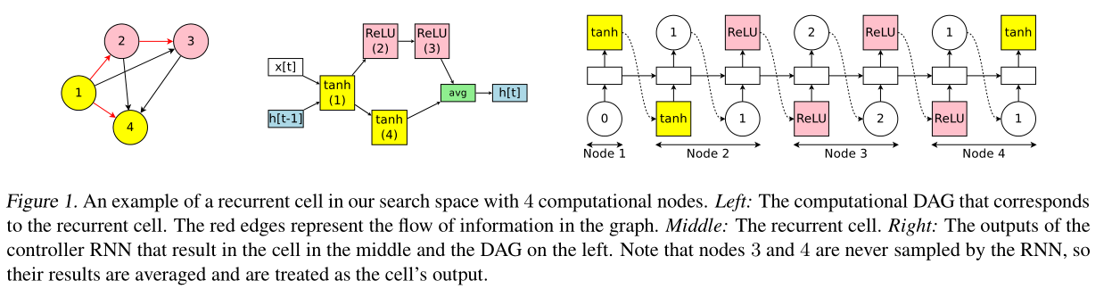
ENAS（ Efficient Neural Architecture Search ）
Designing Recurrent Cells
ENAS’s controller is an RNN that decides:
1) which edges are activated
2) which computations are performed at each node in the DAG

Slide 42
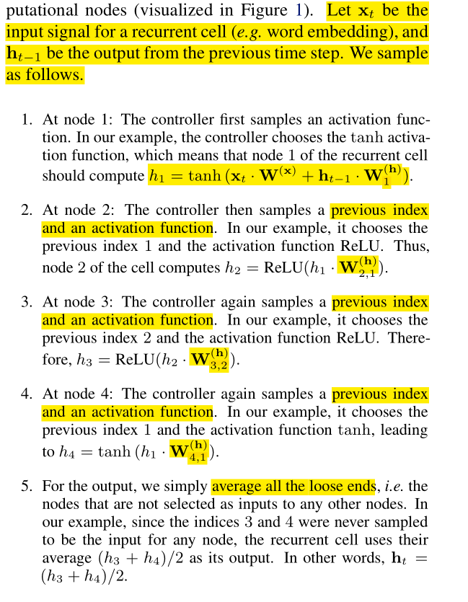
ENAS（ Efficient Neural Architecture Search ）
Designing Recurrent Cells

Slide 43
ENAS（ Efficient Neural Architecture Search ）
Training ENAS and Deriving Architectures
In ENAS, there are two sets of learnable parameters：
1) the parameters of the controller LSTM, denoted by θ
2) the shared parameters of the child models, denoted by ω
The training procedure of ENAS consists of two interleaving phases
First: Training the shared parameters ω of the child models
Second: Training the controller parameters θ
Deriving Architectures

Slide 44
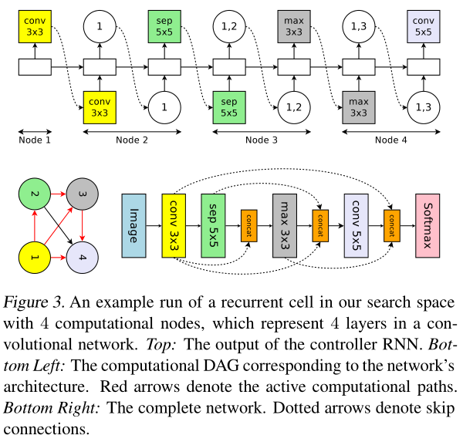
ENAS（ Efficient Neural Architecture Search ）
Designing Convolutional Networks
the controller RNN samples two decisions at each
decision block:
1) what previous node to connect to
2) what computation operation to use

Slide 45
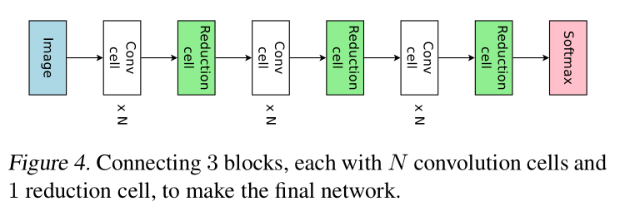
ENAS（ Efficient Neural Architecture Search ）
Designing Convolutional Cells
Rather than designing the entire convolutional network, one can design smaller modules and then connect them together to form a network.

Slide 46
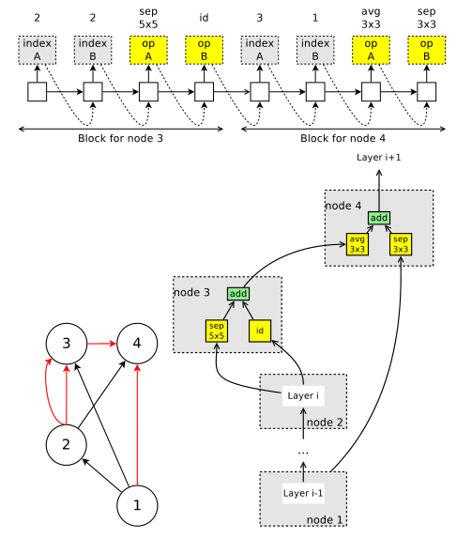
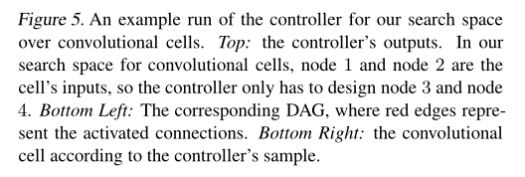
ENAS（ Efficient Neural Architecture Search ）
Designing Convolutional Cells
the controller RNN to make two sets
of decisions:
1) two previous nodes to be used as inputs to the current node
2) two operations to apply to the two sampled nodes

Slide 47

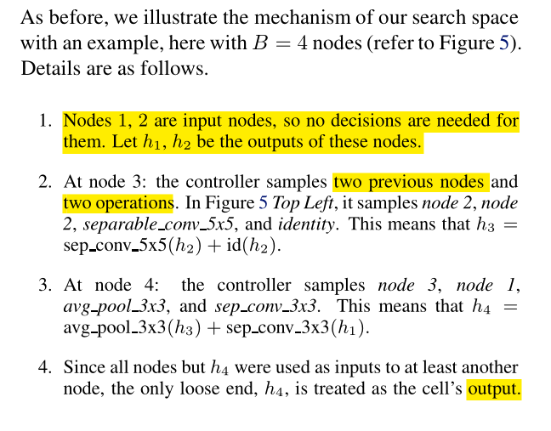
ENAS（ Efficient Neural Architecture Search ）
Designing Convolutional Cells

Slide 48
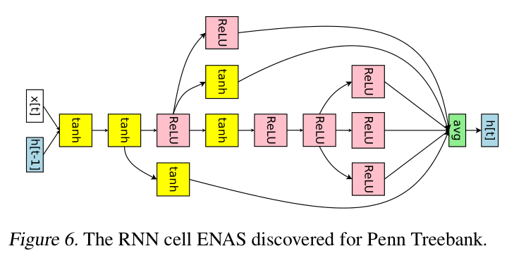
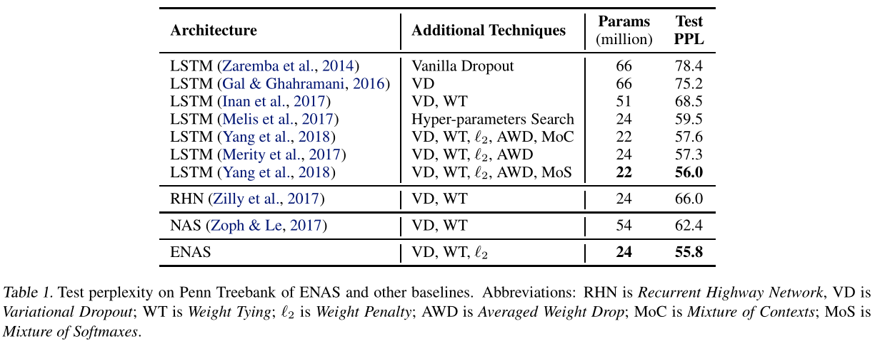
ENAS Experiments
Language Model with Penn Treebank

Slide 49
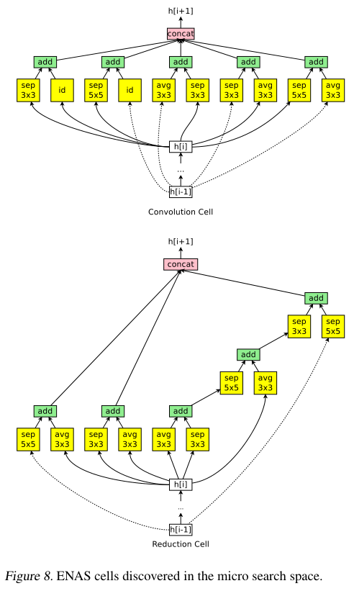

ENAS Experiments
Image Classification on CIFAR-10
Search spaces：
1) the macro search space over entire convolutional models
2) the micro search space over convolutional cells

Slide 50

ENAS Experiments
Image Classification on CIFAR-10

